Slide 1
Practical Machine Learning on Graphs
Pantelis Elinas
November 2019

Slide 2


Course Agenda
Basic definitions
Measures of centrality
Traditional machine learning approach (feature engineering)
Node classification: Laplacian eigenmaps
Node classification: DeepWalk and Node2Vec
Link prediction: DeepWalk and Node2Vec
Node classification: Graph Convolutional Networks
Node classification and link prediction/unsup : GraphSAGE
2 |

Slide 3
Before we start…
Navigate to stellar-practical-ml-on-graphs​ directory
git pull
3 |

Slide 4
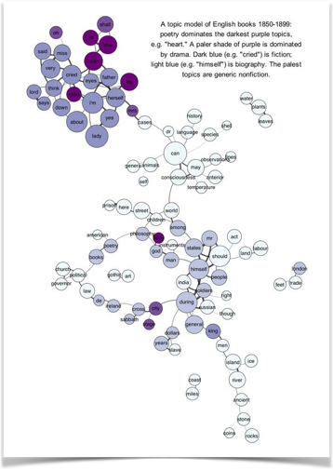

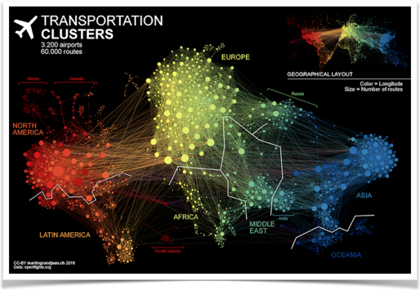
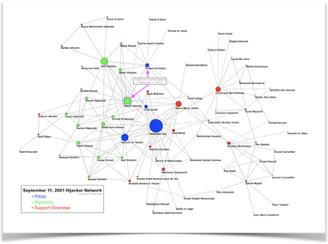
Networks
Topic models
Social networks
Terrorist networks
4 |

Slide 5
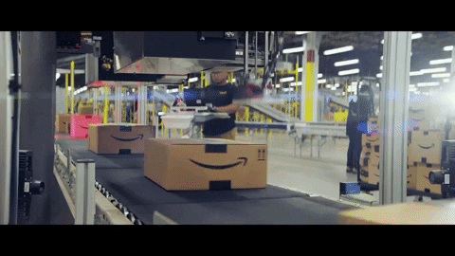
Example
Shipping + Customs: Which package should we inspect?
regular or suspicious?
5 |

Slide 6
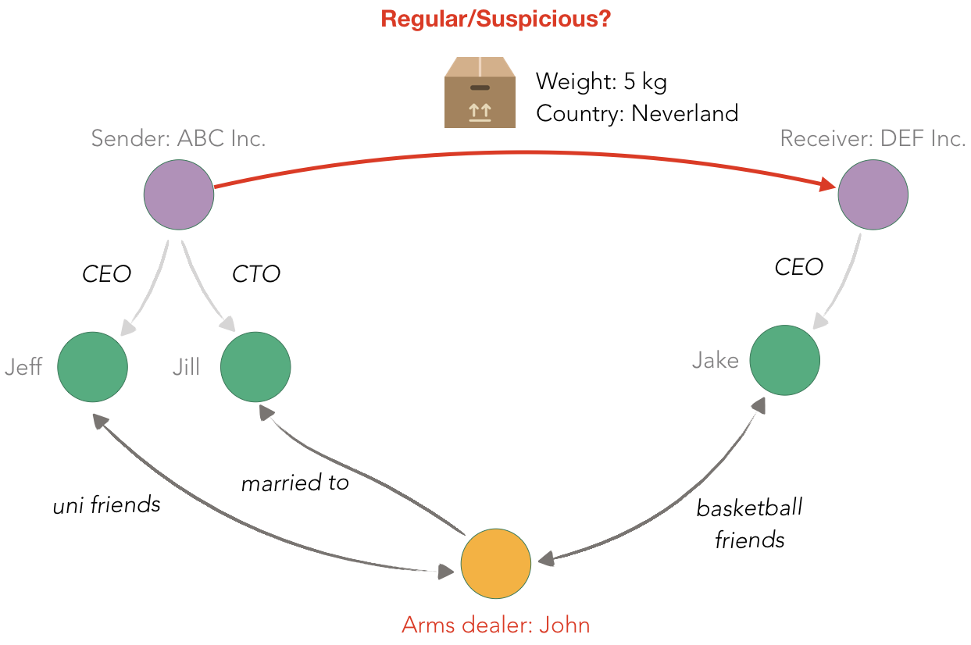
Example
6 |

Slide 7
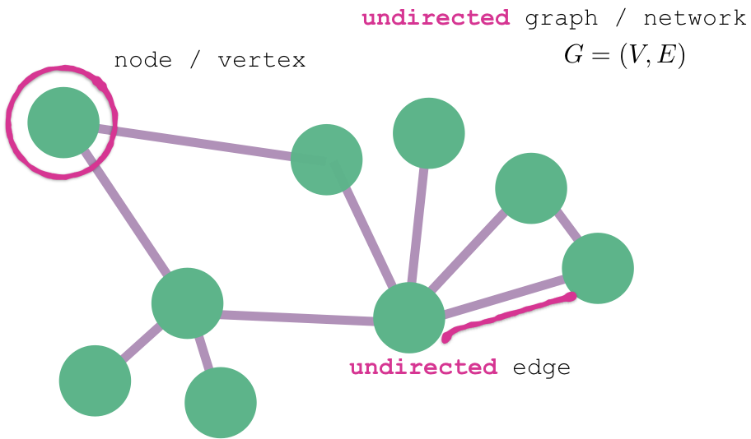
Basic definitions
7 |

Slide 8

Basic definitions
8 |

Slide 9
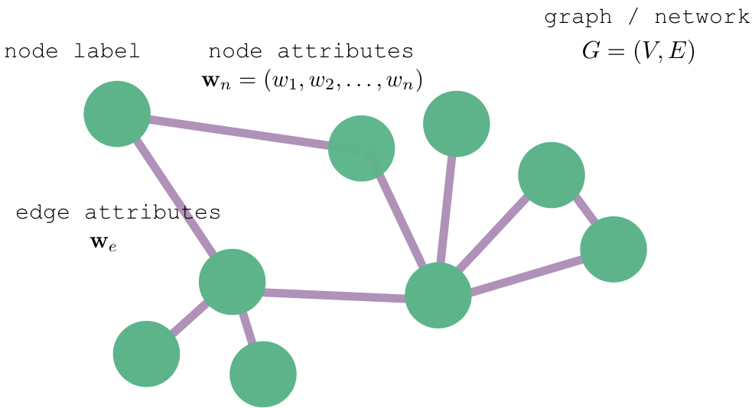

Basic definitions
9 |

Slide 10
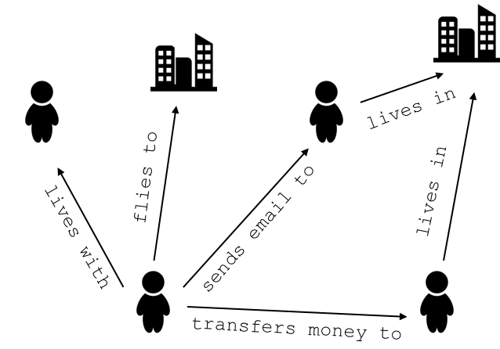
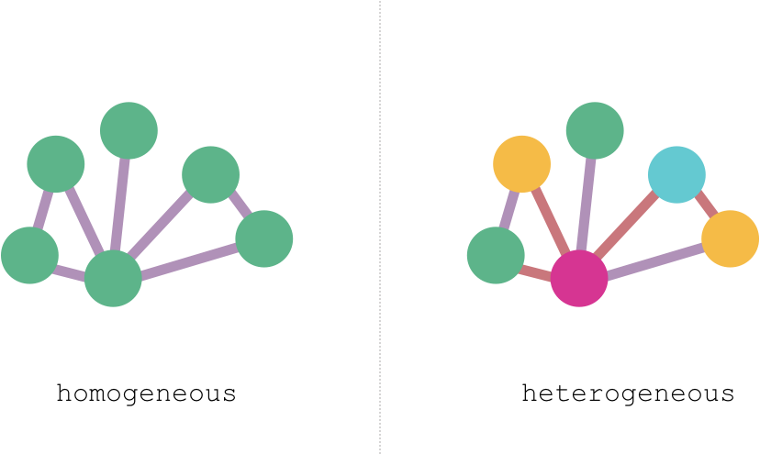
Types of networks
10 |

Slide 11
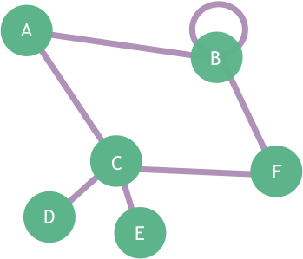
Graph Representations
Adjacency matrix
Edge list
Adjacency list
B,A
B,B
B,F
C,A
C,F
D,C
E,C
B: A,B,F
C: A,F,D,E
D: C
E: C
11 |

Slide 12
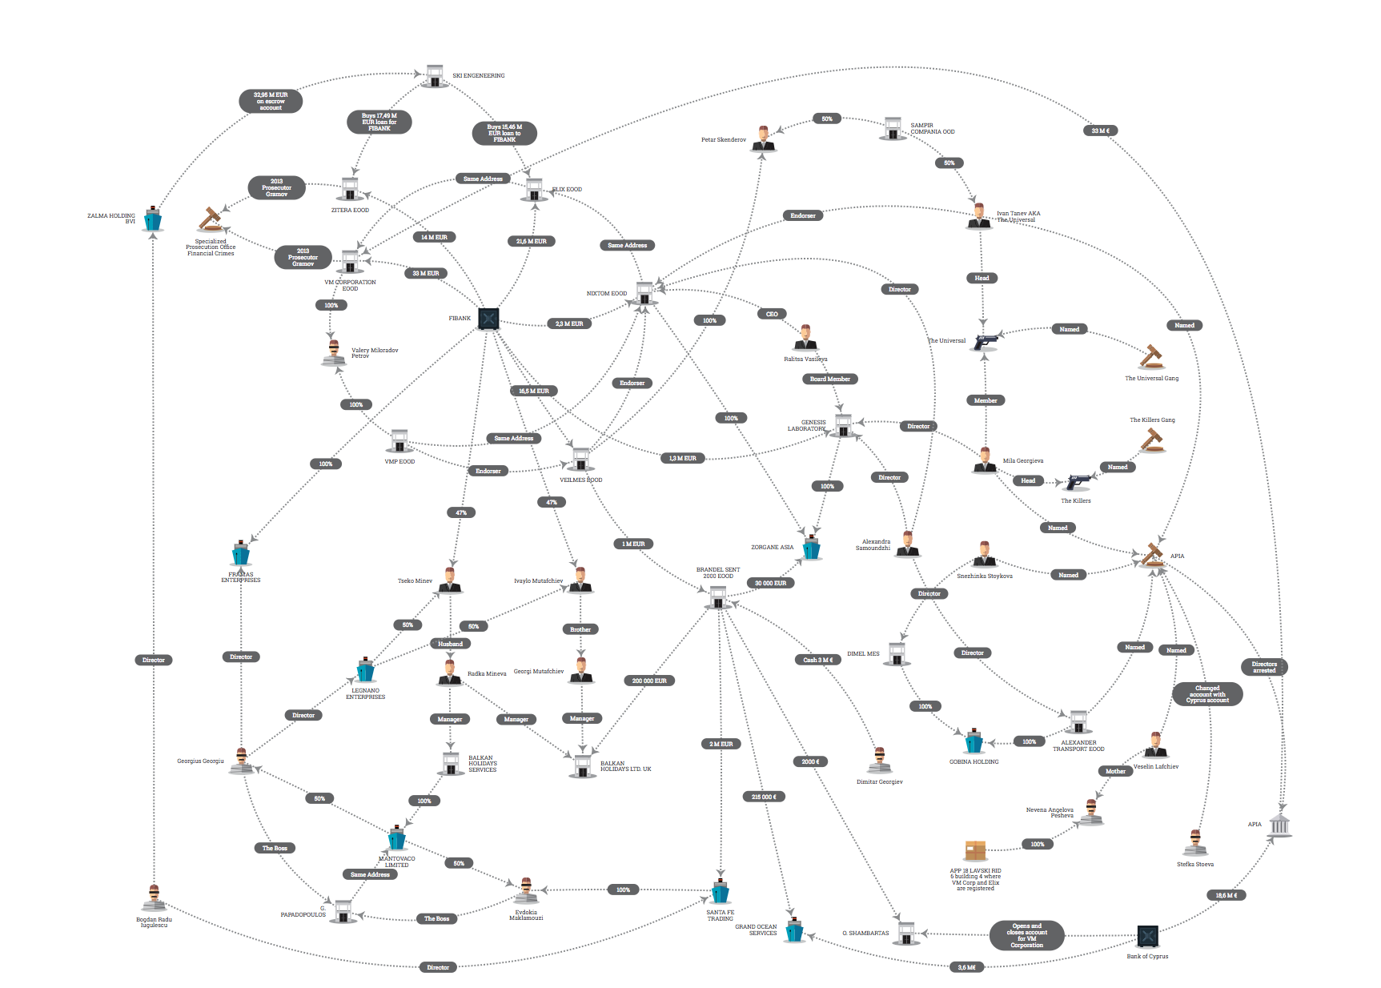
Measures of centrality
Who to investigate? →
Who is important in the network?
Define importance!
vis.occrp.org First Investment Bank Offshore Entities and Romanian APIA connection
12 |

Slide 13
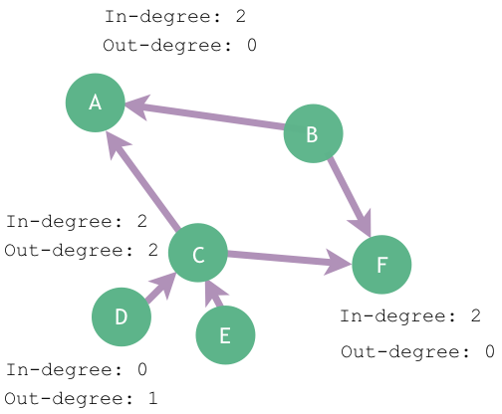
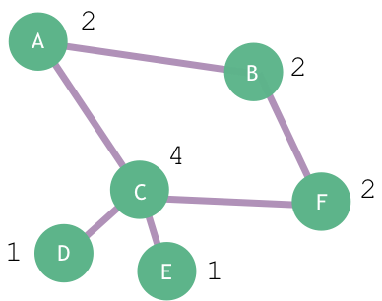

Degree
Degree of a node:
number of neighbours of a node
High degree nodes called hubs
13 |

Slide 14
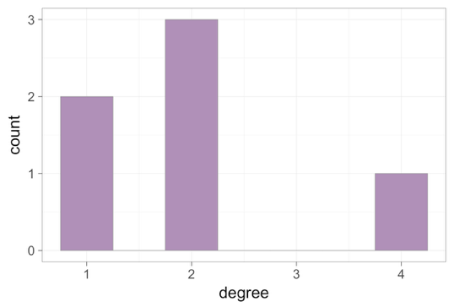
Degree distribution
Probability distribution of the degrees over the entire network
14 |

Slide 15
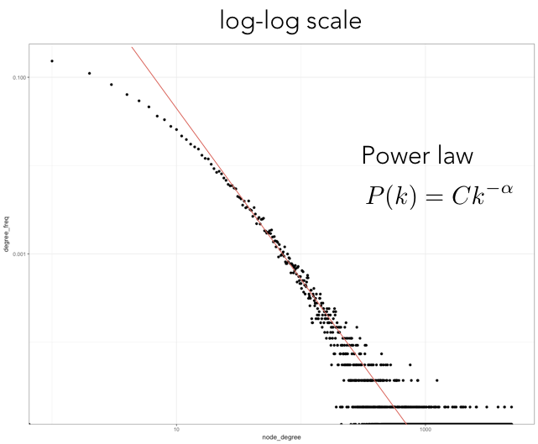
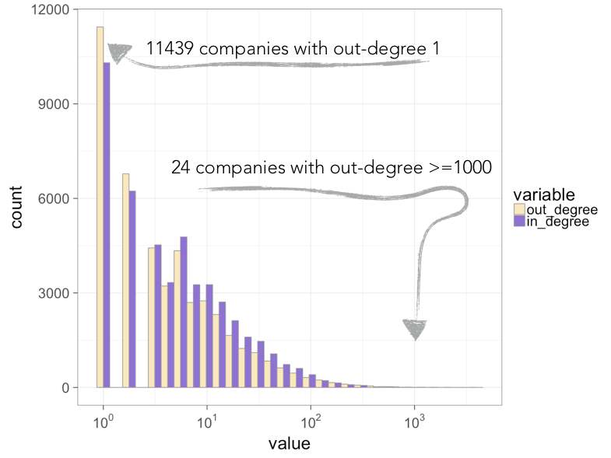
Degree distribution of transactional data between companies
Scale-free networks
15 |

Slide 16
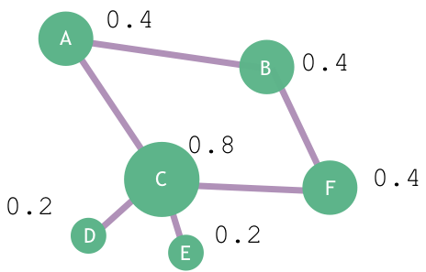
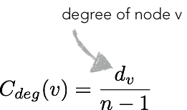
Degree centrality
Important nodes have many connections
16 |

Slide 17
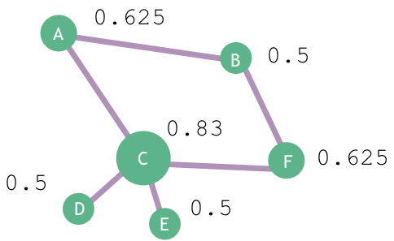
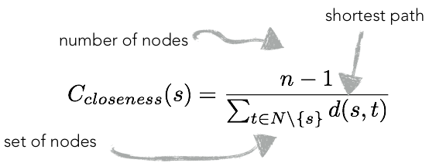
Closeness centrality
Important nodes are close to other nodes
minimal number of steps to reach others
17 |

Slide 18
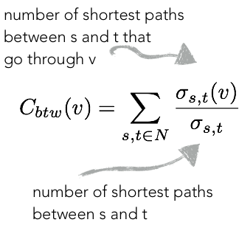
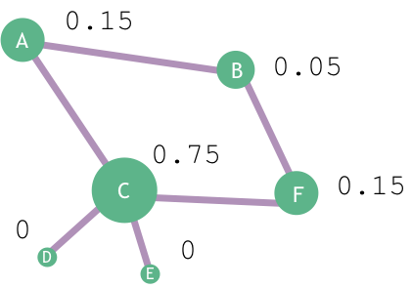
Betweenness centrality
Many shortest paths go through a high betweenness node
Important nodes connect other nodes
18 |

Slide 19
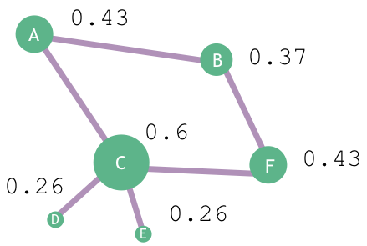
Eigenvector centrality
Important nodes have many connections to other important nodes
(recursive)
19 |

Slide 20
Degree centrality
Closeness centrality
minimal number of steps to reach others
Important nodes have many connections
Important nodes are close to other nodes
Betweenness centrality
Eigenvector centrality
Important nodes have many connections to other important nodes
(recursive)
Important nodes connect other nodes
20 |

Slide 21
21 |

Slide 22


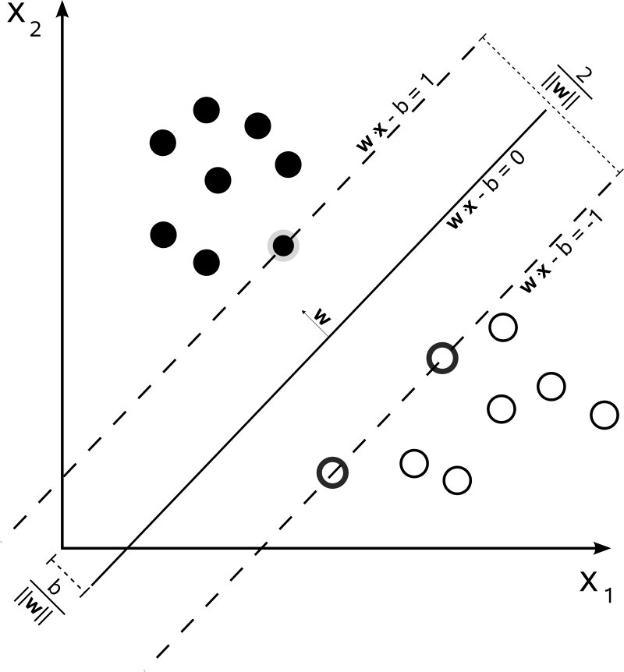
Machine Learning in Practice
A collection of computational methods for automatically detecting patterns in data that can also be used to predict future data.^{[1]}
First | Last | Sex | Income | Age
Homer | Simpson | M | 85000 | 39
Marge | Simpson | F | 0 | 36
Bart | Simpson | M | ? | 10
Lisa | Simpson | F | 0 | 8
Carl | Carlson | M | 90000 | 40
Fat | Tony | M | 15000 | 45
Ned | Flanders | M | 72400 | 38
Machine Learning
Model
SQL
^{[1]} Machine Learning: A Probabilistic Perspective, Kevin P. Murphy, The MIT Press, 2012
22 |

Slide 23
Machine Learning in Practice
A collection of computational methods for automatically detecting patterns in data that can also be used to predict future data.^{[1]}
First | Last | Degree | Betweenness | Age
Homer | Simpson | 3 | 1.2 | 39
Marge | Simpson | 5 | 0.3 | 36
Bart | Simpson | 4 | 0.1 | 10
Lisa | Simpson | 18 | 0.001 | 8
Carl | Carlson | 1 | 0.8 | 40
Fat | Tony | 3 | 0.54 | 45
Ned | Flanders | 2 | 0.001 | 38
Machine Learning
Model
SQL
^{[1]} Machine Learning: A Probabilistic Perspective, Kevin P. Murphy, The MIT Press, 2012
23 |

Slide 24
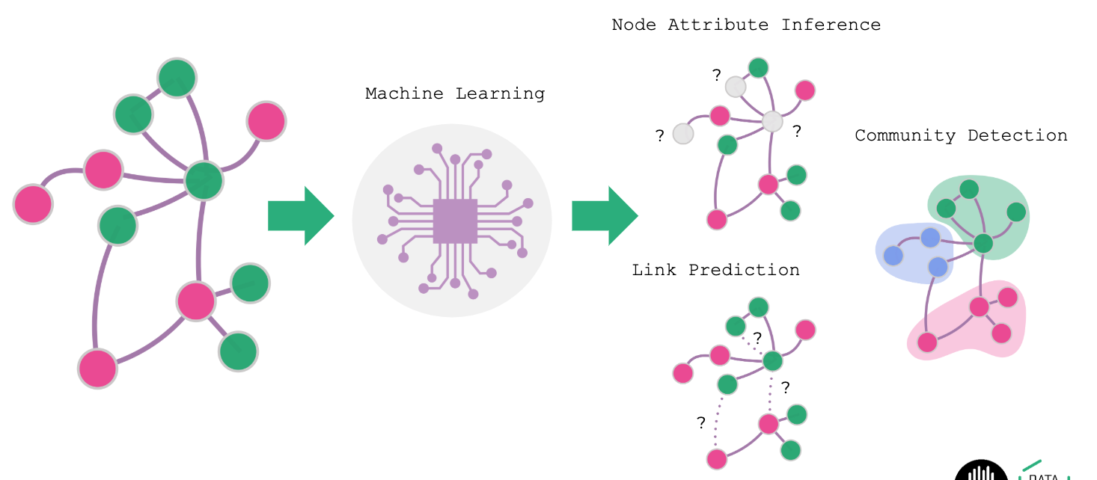
Common tasks on graphs
24 |

Slide 25
Dataset description: Game of Thrones
25 |

Slide 26
Dataset description: CORA network
26 |

Slide 27
Dataset description: CORA features
27 |

Slide 28
Traditional SNA notebook
28 |

Slide 29
Common tasks on graphs
29 |

Slide 30
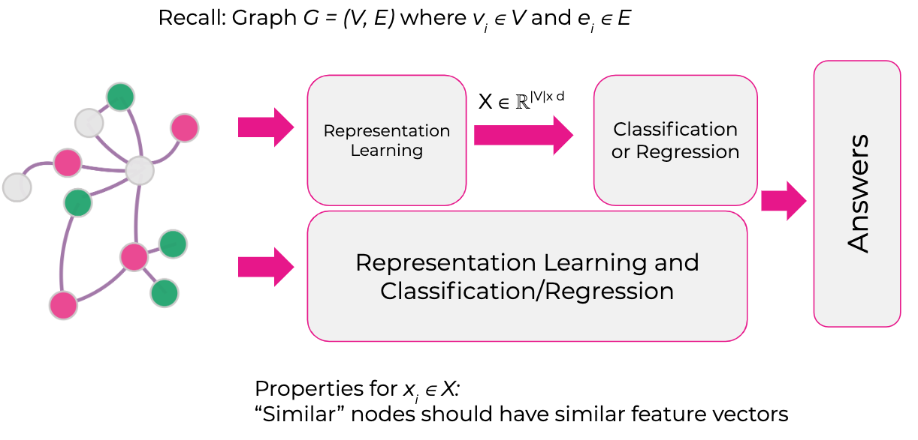
Representation Learning
30 |

Slide 31
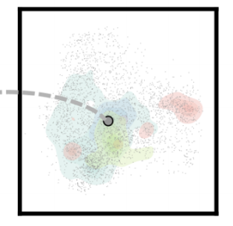
Representation Learning
Embeddings
31 |

Slide 32
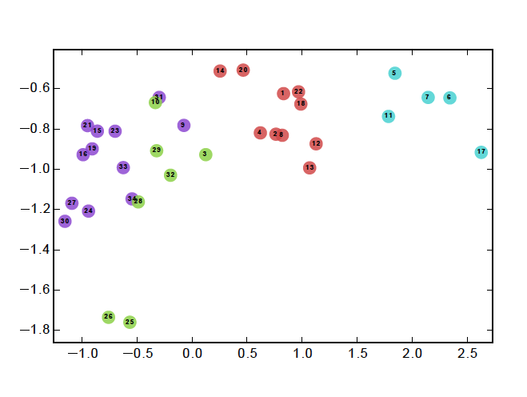
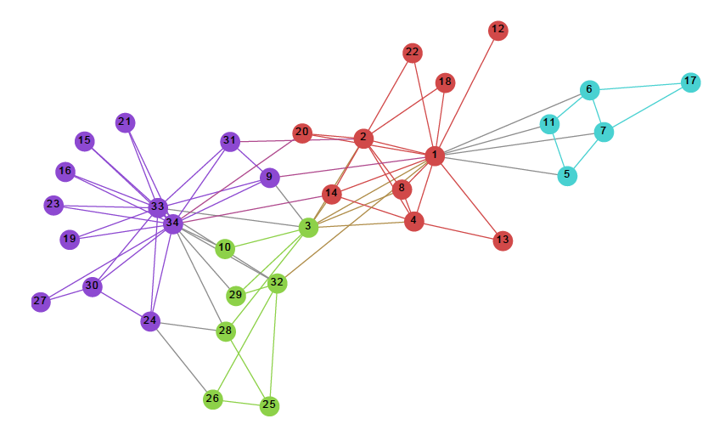
Representation Learning Example
Zachary’s Karate Club Network
Input: Graph
Output: 2D node feature vectors
DeepWalk: Online Learning of Social Representations, B. Perozzi, R. Al-Rfou, and S. Skiena, KDD 2014
32 |

Slide 33
Transductive vs Inductive
Transductive
Graph is static
Inductive
Graph is dynamic
Given a new node in the graph how can we quickly determine a feature vector for it?
Transfer Learning
Train model on one graph and use learned model to answer questions on another (but similar) graph
Laplacian Eigenmaps → DeepWalk → Graph Convolutional Networks (GCN)
33 |

Slide 34
Laplacian Eigenmaps
Representation learning using the geometry of the data
Given are N data X_{i} ∈ R^{F} and labels l.
1
2
1
2
…
…
1
2
20px
20px
k images
34 |
Notes:
The first method we are going to consider has its roots in unsupervised dimensionality reduction. One of the most common methods for dimensionality reduction is PCA.
The problem with PCA is that the objective function only considers the variance of the data and does not look at all at their geometry.
Laplacian Eigenmaps arose from an attempt to consider the geometric of the data manifold in dimensionality reduction.
Let’s look at an example; we are given a number of binary images half of which are of the digit one and the other half of the digit 2. Each image is 20x20 pixels. That’s a 400-dimensional vector representation of each image.
You can see from the examples, however, that each image is actually generated from modifying a small number of parameters, for example translation in x and y directions, orientation, and zoom factor. We would like to discover a representation of each image given in that lower dimensional space (400 vs 4 dimensions).
(describe approach of constructing the graph and then leading to the graph Laplacian definition).
The graph Laplacian is an interesting matrix that corresponds to the Laplacian operator we are all familiar with from Calculus. The graph Laplacian is a clever way to calculate derivatives on graphs by taking the difference of functions defined on graph nodes.
There is much theory behind this but we won’t have time to discuss it. I want to show you how you can use it to do representation learning on a graph.
I simply note that the Laplacian is a symmetric, positive semi-definite matrix and we can calculate its eigenvalues and corresponding eigenvectors.
If the graph is connected (if not, perform these operations on each connected subgraph), then the first eigenvalue is 0 and first eigenvector is constant. We will ignore this first one.
The remaining eigenvectors, we can use as column vectors of an embeddings matrix where each row corresponds to the embeddings for a node in the graph. We can take any subset of the columns to get a projection to a lower dimensional latent space.
Here is some code for calculating the Laplacian and the node embeddings for a citation graph (more on that on the next slide).
Explain python code.
From http://mathworld.wolfram.com/LaplacianMatrix.html:
The Laplacian matrix is a discrete analogue of the Laplacian operator in multivariable calculus and serves a similar purpose by measuring to what extent a graph differs at one vertex from its values at nearby vertices. The Laplacian matrix arises in the analysis of random walks and electrical networks on graphs (Doyle and Snell 1984), and in particular in the computation of resistance distances. The Laplacian also appears in the matrix tree theorem.
------------
Define graph Laplacian L (normalized and un-normalized_
Eigen decomposition of L
Select eigenvectors for which eigenvalues are > 0
What does 0 eigenvalue mean?
Graph should be connected else do above on each subgraph
Rows of matrix made of selected eigenvectors maps nodes to features
Disadvantages
Unsupervised
Does not directly utilize node attributes
Does not scale well with size of graph

Slide 35
Laplacian Eigenmaps on Cora
Let’s apply this method on the Cora citation network dataset
Cora dataset
nodes are papers (2485), and
edges are citation links between papers (5069)
35 |

Slide 36
Exercise
Can you improve the results?
Number of components to keep, 16, 32, 128,…
Different Laplacian,
Normalized Laplacian: I-D^{-1/2}AD^{-1/2}
Random Walk Laplacian: I-D⁻¹A
Different classifier, e.g., Logistic Regression, ensemble?
Utilize node features
36 |

Slide 37
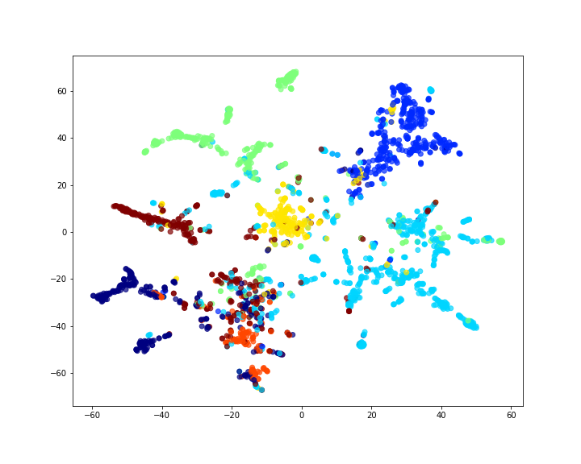
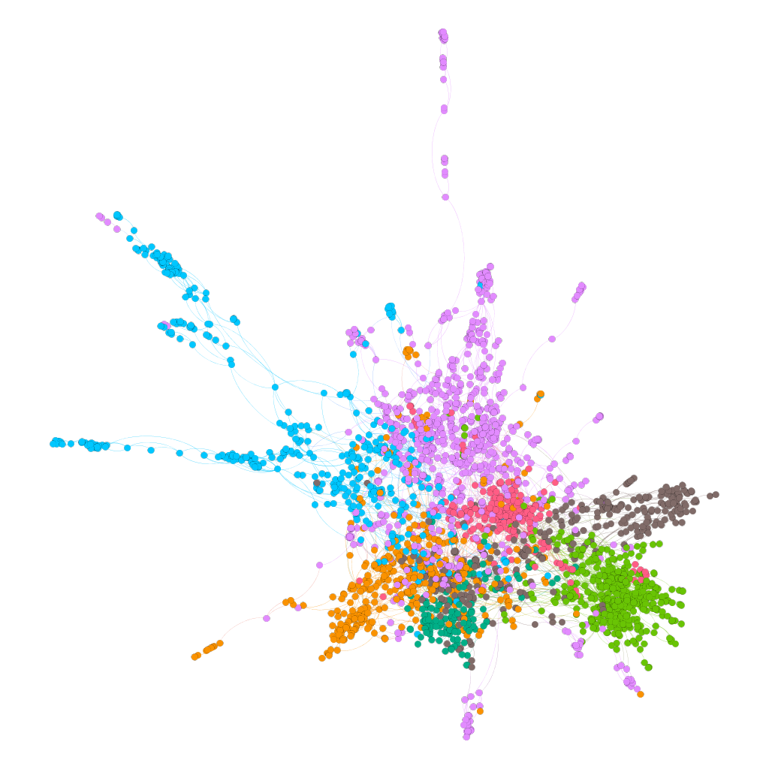
Laplacian Eigenmaps: Cora Example
Cora citation dataset: nodes are papers (2485) and edges are citation links between papers (5069)
Accuracy of Random Forest and 32 dimensions and 140 training examples prediction is ~73%
37 |
Notes:
Show, the results
Explain that results are rather poor; if have time, use the embeddings to train a classifier and give performance
We will now consider methods that can do much better because these methods are much more clever in characterizing the neighborhood of a node.
Discussing Laplacian Eigenmaps was a good way to introduce the basic concept of the graph Laplacian and also to demonstrate why the basic methods fail sort and motivate the need for better methods.
However, because of its ease in implementation, if you have a graph that is small enough to calculate eigenvectors for its, then this approach might be a good starting point; just keep in mind that you can always do better.

Slide 38
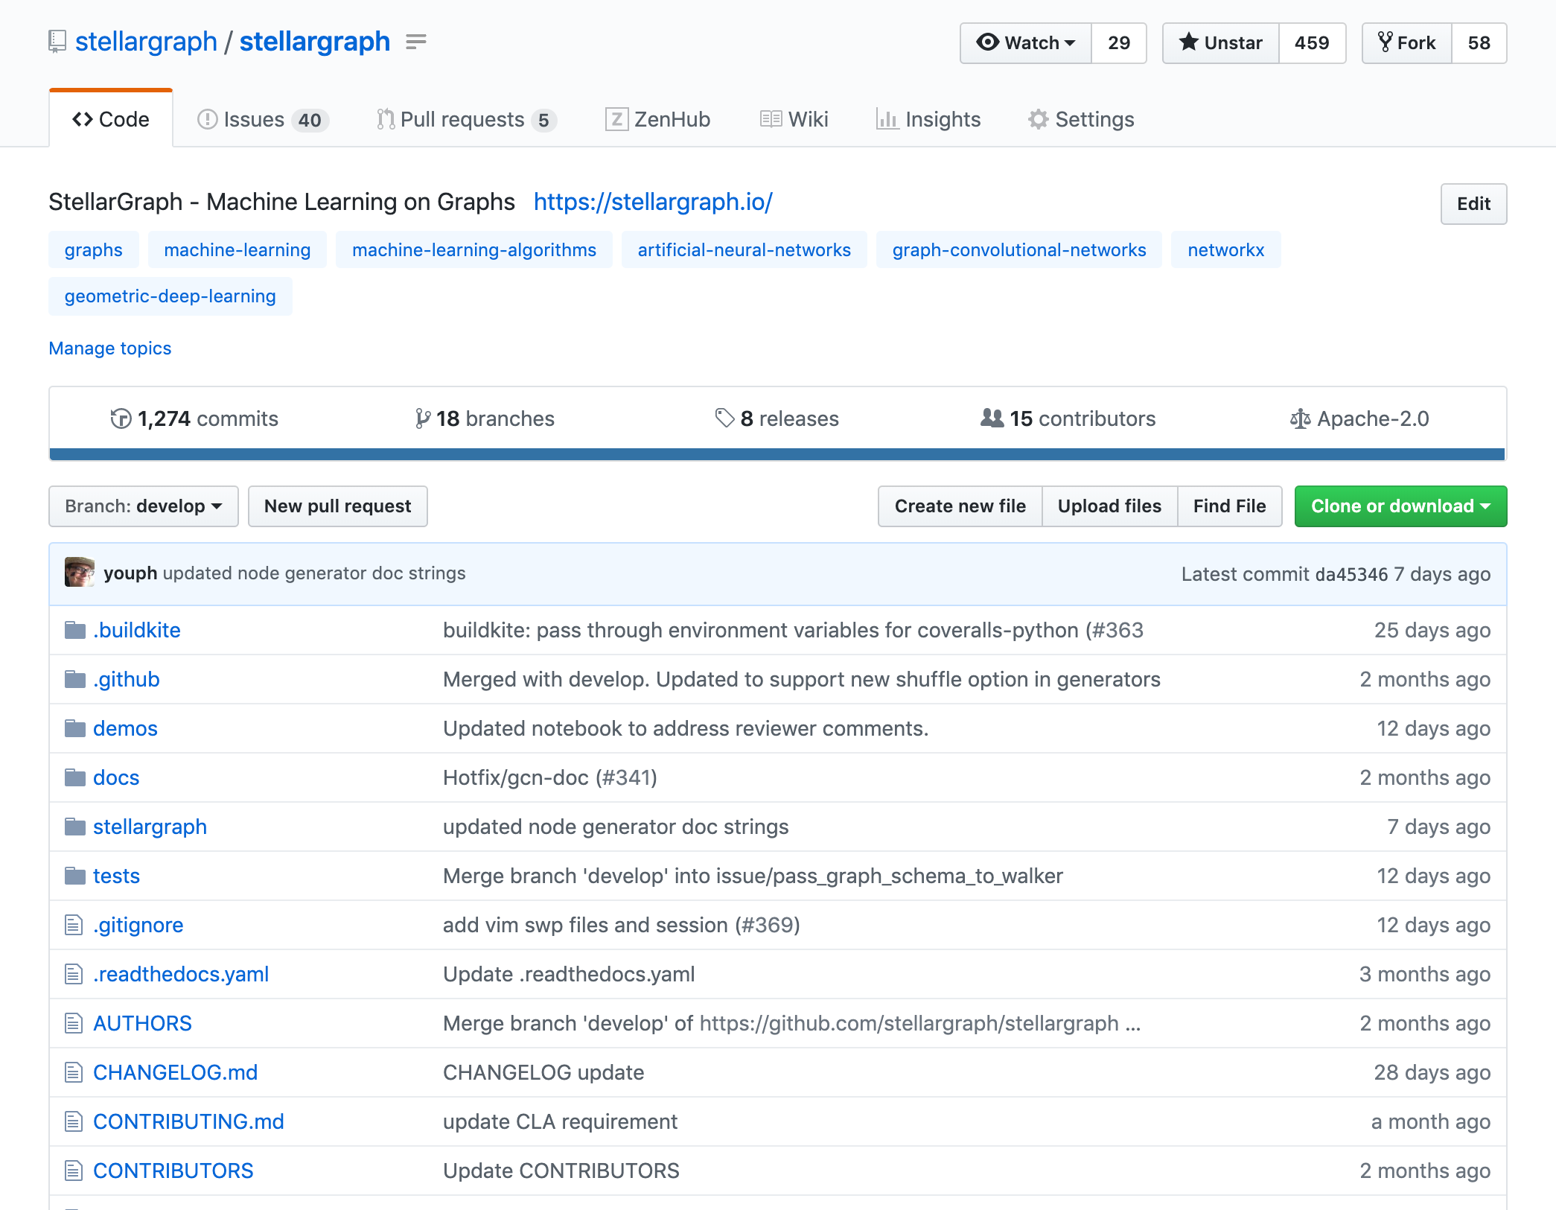
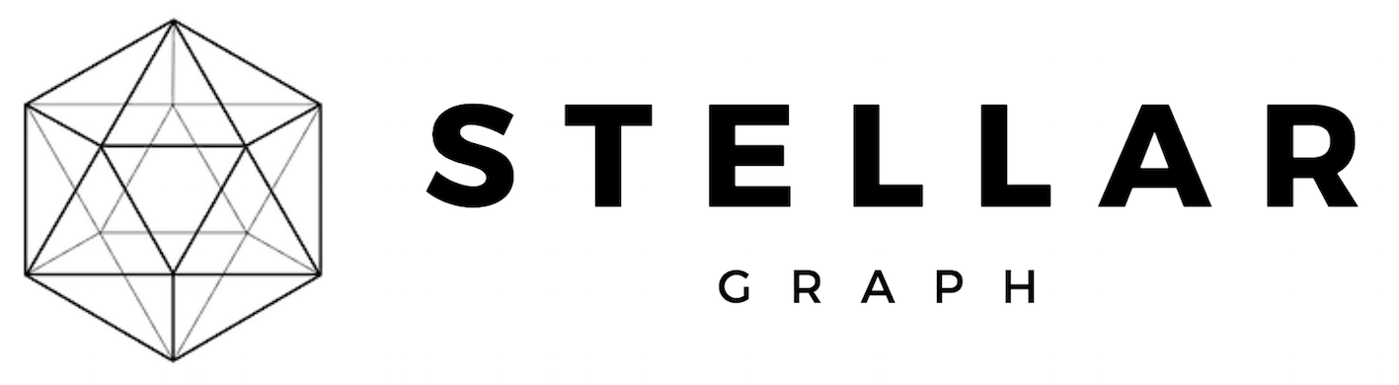


StellarGraph
Python Graph ML library
Open source Apache 2.0 License
https://github.com/stellargraph/stellargraph
https://stellargraph.readthedocs.io/en/stable
https://community.stellargraph.io

Slide 39
DeepWalk: Core Idea
The skip-gram model in Natural Language Processing (Word2Vec)
Consider the sentence: Machine learning on graphs is easy
Window size is 2, and dictionary size |V| = 6
Data: [learning: (Machine, on)], [on: (learning, graphs)], [graphs: (on, is)],…
Skip-gram model: Predict context from word, e.g., predict (Machine, on) from learning
Important
Hidden layer is linear
Two projections matrices: W_{I} ( from input to hidden) and W_{O} (from hidden to output)
Input
Output
Machine
0
Hidden
.6
Machine
learning
1
.0
learning
on
0
.2
on
graphs
0
.1
graphs
Output is Softmax:
is
0
.0
is
easy
0
.1
easy
Objective:
39 |
Notes:
Explain skip-gram model.
Given a large corpus of text document, for each word in a given dictionary (say 10000 words) determine an d-dimensional feature vector such that words semantically similar words cluster together in this d-dimensional latent space.
For each word in the vocabulary, find it in the corpus and extract the words (also in the dictionary) just before and just after it (that is a given window.) The words in this window are the context. Need the word to appear many times in the corpus in order to gather useful statistics about its meaning given its context.
Given the context data for each word we train a neural network (one hidden layer) such that given a word, we can predict its context. The input is a one-hot-vector of size |V| and the output is softmax over |V| words. The network only has one hidden layer.
We use the data from the corpus to find the mapping from input to the hidden layer and from the hidden layer to the output.
What are the word embeddings? (The hidden layer activations or the rows/columns of the input to hidden layer weight matrix or the rows/columns of the hidden to output weight matrix?
It has been shown that this approach produces latent word embeddings that capture the semantic meaning of the words (maybe given the example of man, queen, and woman)
Ok, but how does this relate to graphs? We can use the same approach to compute node embeddings if we define the context of a node in a meaningful way.
Connection between graphs and documents is through power law distribution of node degrees and words in language

Slide 40

DeepWalk: From words to graphs
What is a sentence for a graph?
Idea: Generate sentences by random walks
Random walk properties
Sequence of node IDs: [2,3,4,8,…]
Next node sampled uniformly at random
Walk length is fixed
Start from every node in graph
Make several passes over graph
9
8
5
4
Input
Output
3
2
v₀
0
Hidden
.6
v₀
1
v₁
1
.0
v₁
7
v₂
0
.2
v₂
6
v₃
0
.1
v₃
…
0
.0
…
v₁₁
0
.1
v₁₁
40 |
Notes:
A random walk on a graph, generates a sequence of graph nodes.
Consider this sequence the equivalent of a sentence in a document.
From each node in a graph start a random walk (easy to parallelize) and collect sequence of nodes; choose what edge to follow uniformly at random.
Each walk has a maximum length.
Iterates over all nodes in graph to generate node sequences and optimize NN for each pair of nodes in the context window.
Might need several passes over the data. But, for each iteration, node embeddings are generated so the authors claim that the method is inductive.

Slide 41
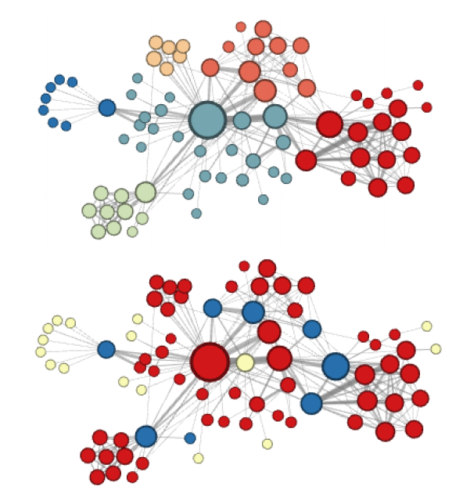
Node2Vec
DeepWalk with biased, second order, random walks
Node2Vec introduces parameters p and q
Homophily
(p=1, q = 0.5)
7
9
1/q
8
1/p
1
5
4
Structural
Equivalence
(p=1, q=2)
3
2
1
Node2Vec: Scalable Feature Learning for Networks, A. Grover and J. Leskovec, KDD 2016
41 |
Notes:
Homophily (similar graph neighborhood) vs structural equivalence (similar role)
Breadth First Search vs Depth First Search
Node2vec manages this trade-off using second-order random walks and transition probabilities controlled by parameters p, q.
Return parameter p controls the likelihood of immediately revisiting a node in the walk. Setting it to a high value (> max(q, 1)) ensures that we are less likely to sample an already visited node in the following two steps.
Parameter q allows the search to differentiate between “inward” and “outward” nodes. if q > 1, the random walk is biased towards nodes close to node t. Such walks obtain a local view of the underlying graph with respect to the start node in the walk and approximate BFS behavior in the sense that our samples comprise of nodes within a small locality. In contrast, if q < 1, the walk is more inclined to visit nodes which are further away from the node t.
Example (from paper) shows the difference between homophily and structural equivalence clustering of nodes (clustering is based on node embeddings for different values for p and q)
Example is Les Misérables co-appearance network

Slide 42
DeepWalk and Node2Vec on Cora
Notebook: Node Attribute Inference
42 |

Slide 43
Exercise
Can you improve the results?
Use different values for p, q to bias the random walker
Use different values for number of walks per node and walk length
Use different values for Word2Vec parameters
Use different downstream classifier, e.g., Random Forest, ensemble, etc.
43 |

Slide 44
Metapath-driven random walks
Metapath2vec: Scalable representation learning for heterogeneous networks, Y. Dong, N. V. Chawla, and A. Swami, KDD 2017
Metapath:
9
Color denotes node type
8
5
4
3
2
7
1
6
44 |
Notes:
Representation learning for heterogeneous graphs
Show metapath driven random walks
Show representation learning example and re-offending example.

Slide 45
Link Prediction Problem Overview
Data is a noisy and partial observation of the world!
WORLD
DATA
Reconstruct
45 |
Notes:
Let’s start by assuming that we are working in a domain that can be completely modeled as a network. This can be a homogeneous or heterogeneous network, for this discussion, it makes no difference.
I call this network, the world; you can call it nature if you want. An example of a world network would be a social network of all people on the planet. I’m not talking about the online social networks such as Facebook, Twitter, LinkedIn etc. I’m talking about the real-world social network that encodes your real relationships with other people, friends, family, acquaintances, co-workers, your enemies, etc.
Now, the bad news are, that the world is inaccessible to us. We don’t have complete access to it.
Instead, we have access to data, that is a noisy and partial observation of the world. The data give us a glimpse into the world. It is partial because we may only have data for a subgraph, e.g., a subset of the nodes in the world, and only a subset of the links in the subgraph. When I say noisy I mean that some of the links in our data may be incorrect, e.g., data entry errors, or missing node and edge attributes, etc.
Given the data, we would like to reconstruct the world…But, if we don’t have access to the world, then how can we tell that our reconstruction is accurate? First of all, we can’t imagine the existence of any missing nodes so for now, let us assume that our data includes a complete set of nodes of a subgraph of the world, and it is only the edges of this subgraph that we are missing and we would like to predict. So, let’s build a model to predict the missing links in our data, that is those links that map our data to the corresponding world subgraph.
Ok, but we still don’t know what the world looks like, so how can we build a predictive model?
Let’s pretend that our data is the world, and then use it to build a predictive model by sampling a subgraph from our data, training a model on the data subgraph and then evaluating or tuning on the full data graph. Our hope is, that said predictive model when finally applied on all our data, it will predict the world subgraph with high accuracy; how to estimate the quality of the learned model is a big topic itself and I won’t go into it today.

Slide 46
Link Prediction Big Picture
Data
[0.1, -0.2, 0.03, 0.01, 0.9,…]
Edge Features
[0.2, 0.2, -0.05, -0.1, 0.9,…]
[0.1, -0.2, -0.5, 0.1, -0.5,…]
f( , ) = [0.1, 0.9, 0.1, -0.5,…]
…
Representation Learning (Nodes)
Solve a classification problem
Edge data
Positive
Negative
+
Edge features
Test
Train
f( , )
Classifier
Edge data
Positive
Negative
Edge data
Positive
Negative
46 |

Slide 47
Data Splitting
Positive edge samples = Easy
Negative edge samples = Not so easy!
2 approaches: Global vs Local
Global
Local
Select source node
Connected by edge?
Sample distance to target node, e.g., 2 hops
Connected by edge?
47 |
Notes:
What is wrong with global method?
The negative examples are easy to predict!

Slide 48
DeepWalk/Node2Vec Link Prediction
What are link/edge representations/embeddings?
An edge connects 2 nodes.
The edge embedding can be a function of the node embeddings
Operators:
Dot product
Mean
Cosine distance
Concatenation
etc.
How do we sample positive and negative examples?
Stellargraph has stellargraph.data.EdgeSplitter class
https://stellargraph.readthedocs.io/en/stable/api.html#module-stellargraph.data
48 |

Slide 49
Link Prediction on Cora
49 |

Slide 50
Exercise
Can you do better?
Different operator for edge embeddings
Different parameters for Node2Vec
Local vs Global edge sampling
https://stellargraph.readthedocs.io/en/stable/api.html#module-stellargraph.data
Different binary classifier
50 |

Slide 51
Representation Learning
Embeddings
51 |

Slide 52
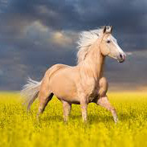
Convolutional Neural Networks 101
Powerful models for structured data
Input
Convolutional
Sub-sampling
Convolutional
Output
Image
Filter
Output
0
0
4
0
3
0
3
1
1
2
0
0
-1
0
1
7
-1
-5
-1
0
2
5
0
2
1
*
-1
0
1
=
3
-2
-4
-2
0
2
0
1
0
2
-1
0
1
5
-1
-3
0
0
0
0
4
0
2
52 |
Notes:
ConvNets
Main assumption: Data, e.g. images, videos, sounds, are compositional, they are formed of patterns that are: local, stationary, and multi-scale.
ConvNets leverage the compositionality structure by extracting compositional features and feed them to classifier, recommender, etc, in an end-to-end fashion.

Slide 53
Images are graphs
An image is a grid and a grid is a (nice) graph
53 |

Slide 54
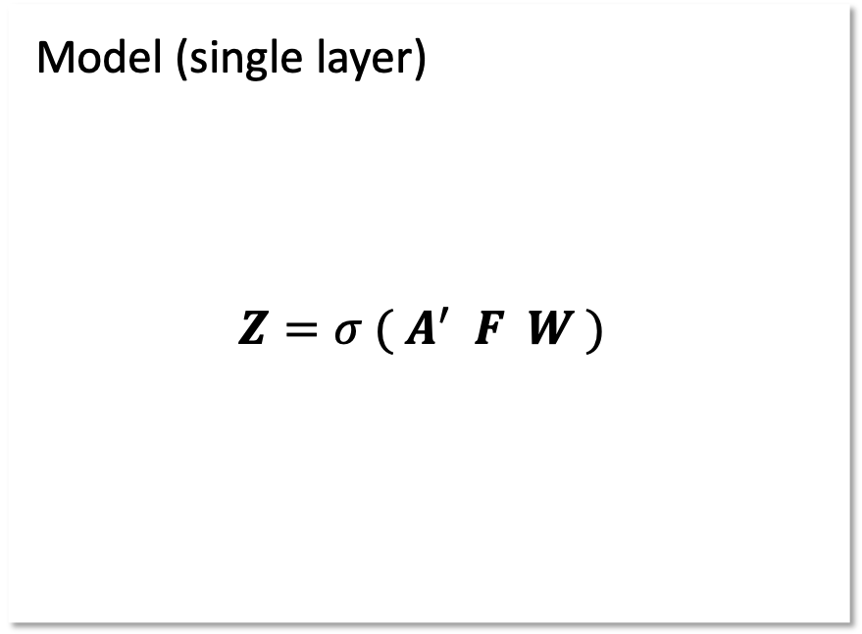
Graph Convolutional Network
Graph Convolutional Networks (GCN): Semi-Supervised Classification with Graph Convolutional Networks. Thomas N. Kipf, Max Welling. International Conference on Learning Representations (ICLR), 2017
Model (single layer)
$$Z=σ ({ A}^{′} F W )$$
graph structure
node features
layer output
trainable weights
non-linearity e.g., ReLU
54 |

Slide 55
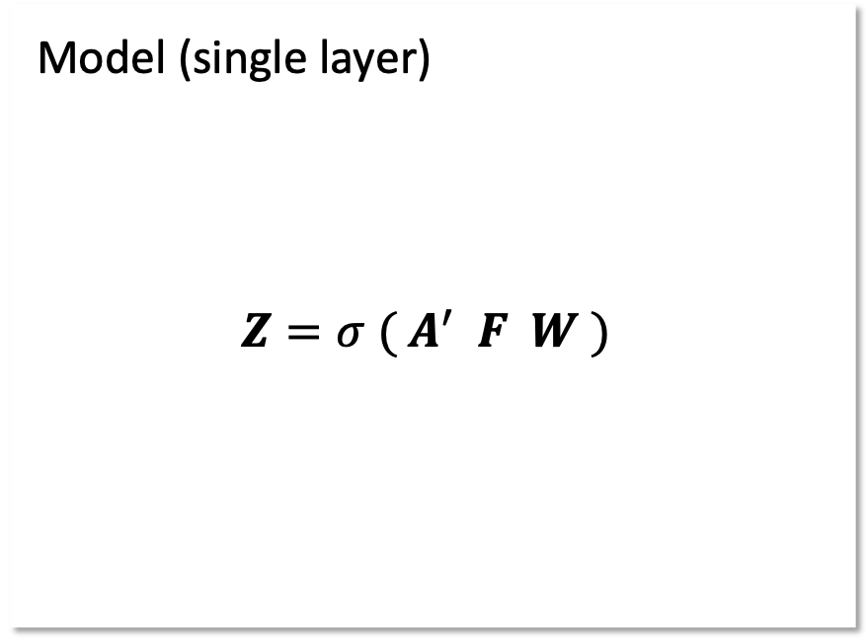
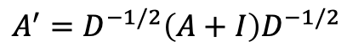
Graph Convolutional Network
Graph Convolutional Networks (GCN): Semi-Supervised Classification with Graph Convolutional Networks. Thomas N. Kipf, Max Welling. International Conference on Learning Representations (ICLR), 2017
Model (single layer)
$$Z=σ ({ A}^{′} F W )$$
A (5x5)
F (5x3)
graph structure
0 | 1 | 0 | 0 | 1
1 | 0 | 0 | 0 | 1
0 | 0 | 0 | 1 | 0
0 | 0 | 1 | 0 | 1
1 | 1 | 0 | 1 | 0
0.5 | 0.25 | 0.25
0.0 | 0.5 | 0.5
0.24 | 0.10 | 0.66
0.9 | 0.1 | 0.0
0.1 | 0.0 | 0.9
node features
x
layer output
trainable weights
non-linearity e.g., ReLU
$$A^{′}=D^{−1/2}\left(A+I\right)D^{−1/2}$$
55 |

Slide 56
Graph Convolutional Networks (GCNs)
Convolutions on general graphs can be defined with respect to L
Let x ∈ ℝ^{N} (scalar for each node in graph)
Let g_{θ}=diag(θ) a filter with θ ∈ ℝ^{N}
Then convolution is defined as,
g_{θ} * x = U g_{θ} U^{T}x
Where U is matrix of eigenvectors of normalized graph Laplacian given by,
L = I_{N} – D^{-1/2}AD^{-1/2}=UΛU^{T}
… (some magic happens here) and,
Convolution can be written
g_{θ} * x ≈ θ(I_{N}+D^{-1/2}AD^{-1/2})x
Generalize to C input channels X ∈ ℝ^{NxC} and normalize matrices such that,
Z = D^{-1/2}(A+I_{N})D^{-1/2}Xϴ where ϴ ∈ ℝ^{CxF} and Z ∈ ℝ^{NxF}
56 |

Slide 57
GCN model
A two-layer GCN has the following forward model (A’ = D^{-1/2}(A+I_{N})D^{-1/2}),
Z = softmax(A’ReLU(A’X ϴ⁽⁰⁾) ϴ⁽¹⁾)
Labelled Examples
X₉
X₈
Z₈
Y₈
Z₉
X₇
Z₇
X₁₀
Z₁₀
Y₁₀
X₀
Hidden Layers
Z₀
X₆
X₁
X₂
Z₂
Y₂
Z₆
Z₁
X₅
X₃
Z₃
Z₅
C
F
X₄
Z₄
Input
Output

Slide 58
GCN on Cora
Let’s predict node labels using GCN
58 |

Slide 59
Exercise
Can you do better?
Different number of layers?
Different size layers?
What if we add a dense layer at the end?
What about GCN with no node features?
59 |

Slide 60
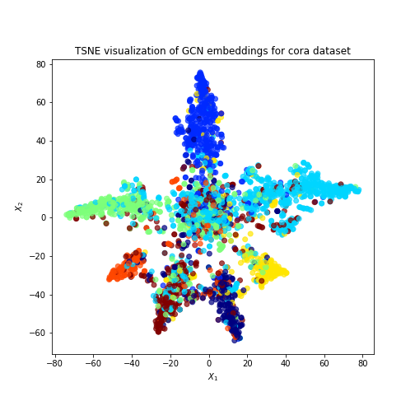
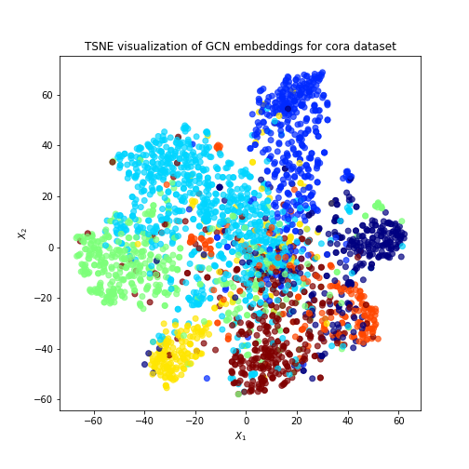
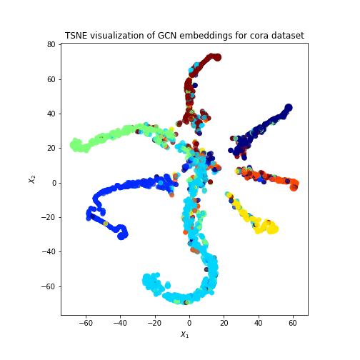
GCN: Example
Attribute inference on Cora, with and without attributes
GCN no node attributes
accuracy ~ 0.65
Output of last GCN layer
GCN + node attributes
accuracy ~ 0.76,
Output of first GCN layer
GCN + node attributes
accuracy ~ 0.76
Output of last GCN layer

Slide 61
GCN Limitations
GCN does not scale well
Full batch
Memory requirements grow linearly with dataset size
Undirected graphs
Homogeneous graphs
Transductive only
What if we add just a single new node to the graph?
What if we want to train on one graph and make predictions with another graph?
Can we have GCN power without the above limitations?
61 |

Slide 62
GraphSAGE model
Use sampling and aggregation over node neighbors!
Image from http://snap.stanford.edu/graphsage/
62 |
Notes:
GraphSAGE uses a neighborhood sampling scheme and aggregation operator that scales to large graphs.
Since the embedding of a node depends on the parameters of the aggregator functions (that fuse information from the node’s local neighborhood) it can be used to generate embeddings for nodes that were not available in the graph during training. That is GraphSAGE is an inductive method that generalizes well and applies to large graphs.
Explain how the sampling and aggregation works using the figure as a guide before going into more detail in the next slide.

Slide 63
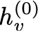
GraphSAGE model
Use sampling and aggregation over node neighbors!
Update for node v:
node v
=
Image from http://snap.stanford.edu/graphsage/
63 |
Notes:
GraphSAGE uses a neighborhood sampling scheme and aggregation operator that scales to large graphs.
Since the embedding of a node depends on the parameters of the aggregator functions (that fuse information from the node’s local neighborhood) it can be used to generate embeddings for nodes that were not available in the graph during training. That is GraphSAGE is an inductive method that generalizes well and applies to large graphs.
Explain how the sampling and aggregation works using the figure as a guide before going into more detail in the next slide.

Slide 64
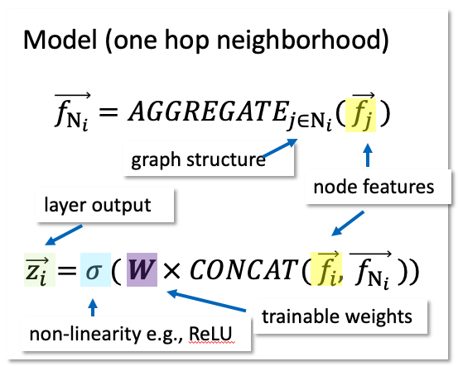
GraphSAGE model
Use sampling and aggregation over node neighbors!
node v
Image from http://snap.stanford.edu/graphsage/
64 |
Notes:
GraphSAGE uses a neighborhood sampling scheme and aggregation operator that scales to large graphs.
Since the embedding of a node depends on the parameters of the aggregator functions (that fuse information from the node’s local neighborhood) it can be used to generate embeddings for nodes that were not available in the graph during training. That is GraphSAGE is an inductive method that generalizes well and applies to large graphs.
Explain how the sampling and aggregation works using the figure as a guide before going into more detail in the next slide.

Slide 65
GraphSAGE on Cora (Node Classification)
Let’s predict node labels using GraphSAGE
65 |

Slide 66
Exercise
Can you improve the results?
Different number of neighbors per depth
Deeper network, sample more than K=2 hops away
Wider network
Different aggregator functions?
https://stellargraph.readthedocs.io/en/stable/api.html#module-stellargraph.layer.graphsage
66 |

Slide 67
GraphSAGE on Cora (Link Prediction)
Let’s try link prediction with GraphSAGE
67 |

Slide 68
Model Calibration
Consider the output of a classification model
What does this output represent?
Can we trust it?
68 |

Slide 69
GNN Ensembles
69 |
Notes:
Probabilistic predictions.

Slide 70
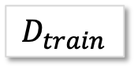
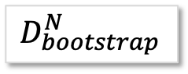
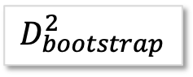
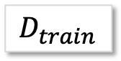
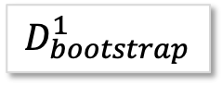
Ensembles (Training)
Need diversity
Randomized weight initialization (Naive)
Sampling of training data (Bagging)
$$D_{train}$$
$$D_{train}$$
$$D_{bootstrap}^{1}$$
$$D_{bootstrap}^{2}$$
$$D_{bootstrap}^{N}$$
Model 1
Model 2
…
Model N
Model 1
Model 2
…
Model N
Naive
Bagging
GraphSAGE, GCN, GAT, etc.
70 |

Slide 71
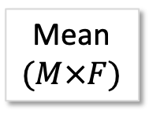
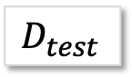

Ensembles (Predicting)
$$D_{test}$$
Model 1
Model 2
…
Model N
N: Number of models
K: Number of predictions per query point
M: Number of query points
F: Output dimensionality
Mean
$$(M×F)$$
Union
$$(N×K×M×F)$$
71 |

Slide 72
Ensembles for classification
72 |

Slide 73

But There is More...
https://github.com/stellargraph/stellargraph

Slide 74
Other Topics
Weighted Random Walks
Graph Attention Networks
GAT
GraphSAGE with GAT aggregator
Unsupervised convolutional neural network methods
GraphSAGE
Heterogeneous Networks
Metapath2Vec
HinSAGE
Model Calibration
Model Ensembles
74 |

Slide 75
Other Approaches
FastGCN: Fast learning with Graph Convolutional Networks via importance sampling, J. Chen, T. Ma, and C. Xiao, ICLR 2018
Metapath2Vec: Scalable representation learning for heterogeneous networks, Y. Dong, N. V. Chawla, and A. Swami, KDD 2017
GraphSAGE: Inductive Representation Learning on Large Graphs, W. Hamilton, R. Ying, and J. Leskovec, NIPS 2017
GAT: Graph Attention Networks, P. Velickovic, G. Cucurull, A. Casanova, A. Romero, P. Lio, and Y. Bengio, ICLR 2018
Decagon: Modeling polypharmacy side effects with Graph Convolutional Networks, M. Zitnik, M. Agrawal, and J. Leskovec
75 |

Slide 76
References
Laplacian Eigenmaps and Spectral Techniques for Embedding and Clustering, M. Belkin and P.Niyogi, NIPS 2002
Distributed Representations of Words and Phrases and their Compositionality, T. Mikolov, I. Sutskever, K. Chen, G. Corrado, and J. Dean, NIPS 2013
DeepWalk: Online Learning of Social Representations, B. Perozzi, R. Al-Rfou, and S. Skiena, KDD 2014
Node2Vec: Scalable Feature Learning for Networks, A. Grover and J. Leskovec, KDD 2016
Semi-Supervised Classification with Graph Convolutional Networks, T. N. Kipf and M. Welling, ICLR 2017
Inductive Representation Learning on Large Graphs, W. L. Hamilton, R. Ying, and J. Leskovec, NIPS 2017
Representation Learning on Graphs: Methods and Applications, W. L. Hamilton, R. Ying, and J. Leskovec, arXiv preprint arXiv:1709.05584 2017
76 |

Slide 77
Open Source Implementations
StellarGraph: https://github.com/stellargraph/stellargraph
Implementations for DeepWalk, Node2Vec, Metapath2Vec, GCN, GAT, GraphSAGE, and HINSAGE.
DeepWalk: https://github.com/phanein/deepwalk
Node2Vec: http://snap.stanford.edu/node2vec/
Metapath2Vec: https://ericdongyx.github.io/metapath2vec/m2v.html
GCN: https://github.com/tkipf/gcn
FastGCN: https://github.com/matenure/FastGCN
GraphSAGE: http://snap.stanford.edu/graphsage/
GAT: https://github.com/topics/graph-attention-networks
77 |

Slide 78
Thank you
Engineering and Design
Pantelis Elinas/Anna Leontjeva Senior Research Engineer/Senior Data Scientist
e pantelis.elinas@data61.csiro.au/anna.leontjeva@data61.csiro.au

Slide 80

Graph ML Problem: Node Classification
Labor | ?
Liberal | ?
Green | ?
Labor | ✖️
Liberal | ✔️
Green | ✖️
Labor | ✖️
Liberal | ✔️
Green | ✖️
80 |

Slide 81
Graph ML Problem: Link Prediction
?
?
81 |

Slide 82
Graph ML Problem: Community Detection
82 |

Slide 83
Datasets
83 |

Slide 84
CORA citation network
84 |

Slide 85
CORA node features
85 |

Slide 86

Hateful twitter users network
[f₀, f₁, f₂, …, f₂₀₄]
Features, f_{i}, are derived from user tweets
and activity
retweets
# Users: 100K
# Edges: 2200K
# Annotated Users: 5K
Dataset: https://www.kaggle.com/manoelribeiro/hateful-users-on-twitter/home
86 |

Slide 87

BlogCatalog
Heterogeneous network
No attributes
Statistics
Bloggers: 10,312
Groups: 39
Edges: ~333K
Edges are between bloggers and between bloggers and groups
87 |

Slide 88









Traditional ML workflow
1
2
3
1
Prepare Data
2
Specify and Train Model
3
Evaluate Model and
Visualize Results
Train
Test
88 |

Slide 89
Traditional ML for Twitter dataset
[f₀, f₁, f₂, …, f₂₀₄]
[f₀, f₁, f₂, …, f₂₀₄]
❌
[f₀, f₁, f₂, …, f₂₀₄]
✅
[f₀, f₁, f₂, …, f₂₀₄]
89 |

Slide 90
Hateful twitter users network
[f₀, f₁, f₂, …, f₂₀₄]
Features, f_{i}, are derived from user tweets
and activity
retweets
# Users: 100K
# Edges: 2200K
# Annotated Users: 5K
Dataset: https://www.kaggle.com/manoelribeiro/hateful-users-on-twitter/home
90 |

Slide 91
StellarGraph
Python Graph ML library
Open source Apache 2.0 License
https://github.com/stellargraph/stellargraph
https://stellargraph.readthedocs.io/en/stable
https://community.stellargraph.io

Slide 92

Graph ML workflow
1
2
3
1
Prepare Data
2
Specify and Train Model
3
Evaluate Model and
Visualize Results
Train
Test
92 |

